Slide 1
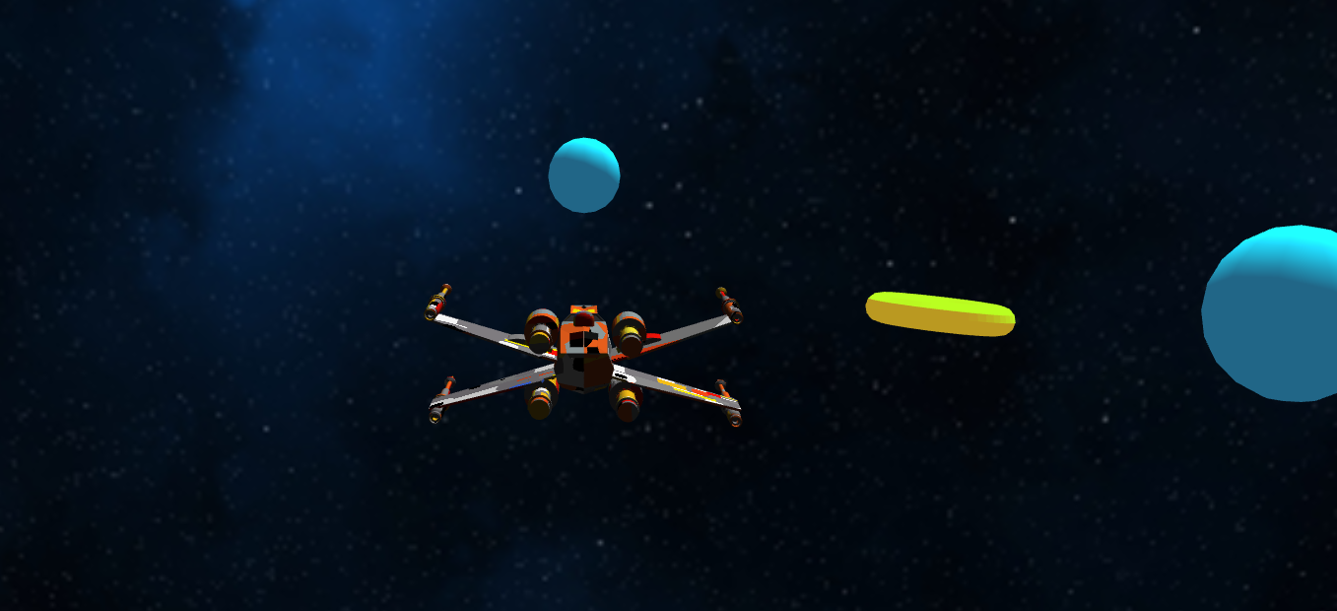
Ring Chaser Graphic Engine
Move Spaceship:
A- Left
D-Right
W-Forward
S- backwards
Light Type
1-Direct (Default)
2-Spot
3-Point
Ambiant Light Type
4- Ambient (default)
5- Hemispheric
6-Sh
Diffuse Light Type
7-Lambert (default)
8- Toon
9-Oren-Nayar
Specular Light Type
Z- Phong
X-Blinn
C-ToonP
V-ToonB
B-Cook Torrence
R-node (default)
Emitted Light
Y-yes
N-no (default)

Slide 2
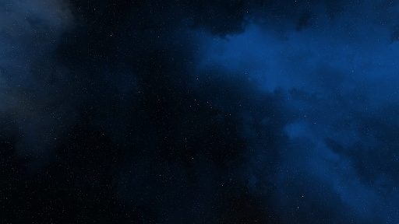
Features
Scan Line rendering
Z Buffer
Clipping
BackfaceCulling
Light Models : Directional , Point light , Spot lights
BRDF Models: Diffuse: Lambert ,Toon, Oren Nayar. Specular : Phong, Blinn, Toon, Cook Torrance
Smooth Shading: Phong Shading
Movements : Quaternion and interpolation
Parent/Child relations
Hand made look at camera
Skybox
To be continued : Two pass rendering with ray casting.

Slide 3
Authors:
Ginevra Lorio
Yunus Ege Saygili
Thibault Fievez

